Slide 1
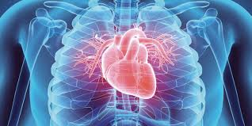


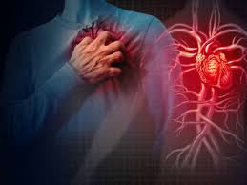
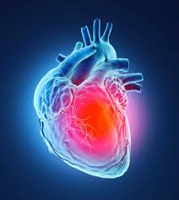
Heart Disease Prediction Using Deep Learning
Presented by – Aritra Mukherjee
ID: UMIP270247
Machine Learning Intern
At - Unified Mentor Pvt. Limited
Aritra Mukherjee

Slide 2
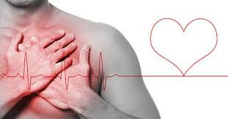
Introduction To Project –
Heart Disease Prediction
This project aims to build an intelligent system capable of predicting the presence of heart disease in a patient based on clinical data.
It leverages modern machine learning and deep learning techniques, wrapped in a user-friendly interface developed using Streamlit.
Users can input medical parameters, and the model provides an instant prediction with confidence.
Aritra Mukherjee

Slide 3


GOAL
To predict whether a patient has heart disease using machine learning.
Provide a simple and interactive tool for quick heart health assessment.
Enhance early diagnosis and awareness through AI support.
Aritra Mukherjee

Slide 4
Dataset Overview for Classification
Total Features:
11 input features + 1 target
Key Attributes:
Age, Sex, Chest Pain Type
Resting Blood Pressure, Cholesterol
Fasting Blood Sugar, Resting ECG
Maximum Heart Rate, Exercise-Induced Angina
ST Depression (Oldpeak), ST Segment Slope
Target: 0 = Healthy, 1 = Heart Disease
Aritra Mukherjee

Slide 5
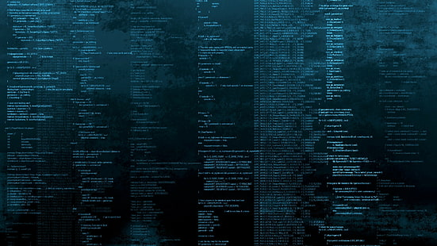
Tech Stack
Technologies & Tools Used
Python:
Core language for implementation
Pandas, NumPy:
Data manipulation and preprocessing
Matplotlib, Seaborn:
Data visualization and analysis
Scikit-learn:
Feature scaling, model evaluation
TensorFlow / Keras:
Deep learning model (Sequential Neural Network)
Pickle & JSON:
Saving scaler and feature info
Streamlit:
Web-based user interface for prediction
Aritra Mukherjee

Slide 6
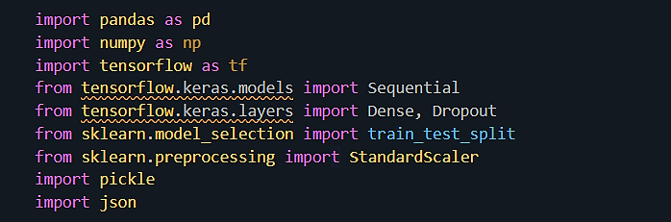
Import Required Libraries
Aritra Mukherjee

Slide 7
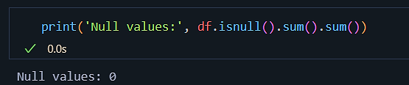



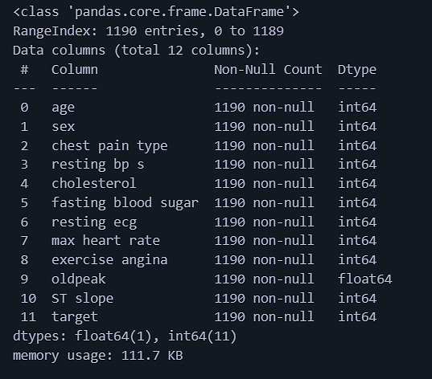
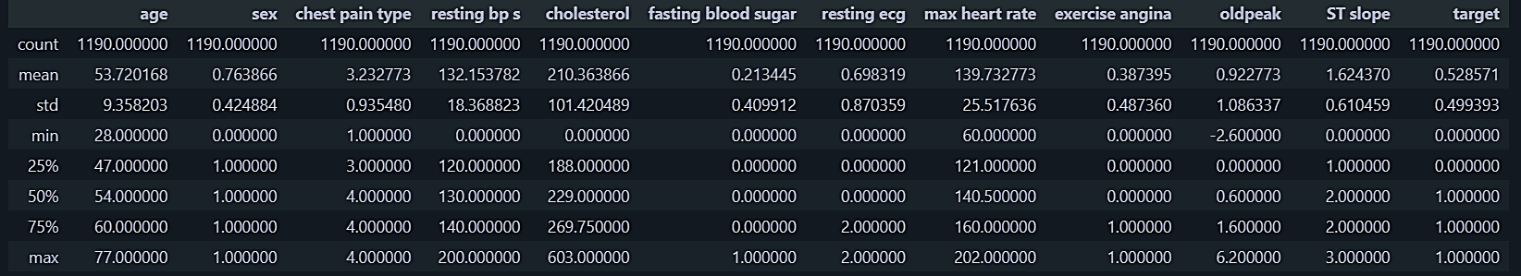
Explore The Dataset
Aritra Mukherjee

Slide 8
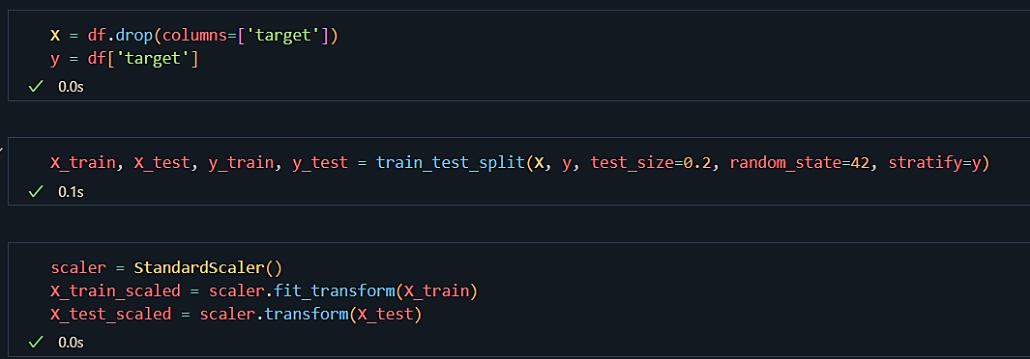
Preprocessing (StandardScaler), model building (train_test_split)
Aritra Mukherjee

Slide 9
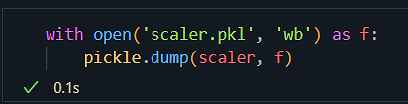
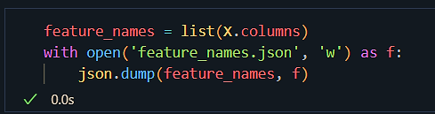
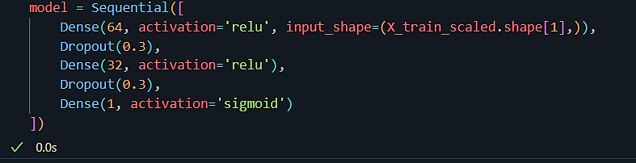

Model Saving
Scaler saved with pickle as - scaler.pkl
Feature list saved as - feature_names.json
Sequential Model Configuration
Aritra Mukherjee

Slide 10
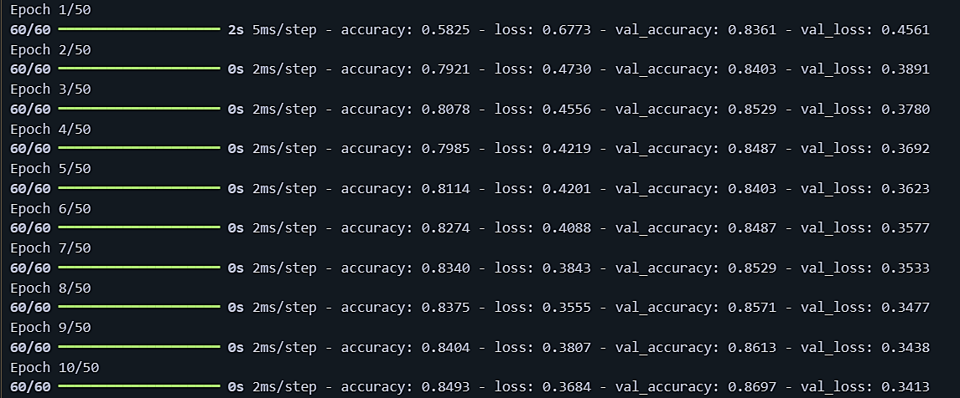
Train the Model
…
Aritra Mukherjee

Slide 11



Evaluate the Model
Accuracy – 88%
Save the Trained Model
Aritra Mukherjee

Slide 12
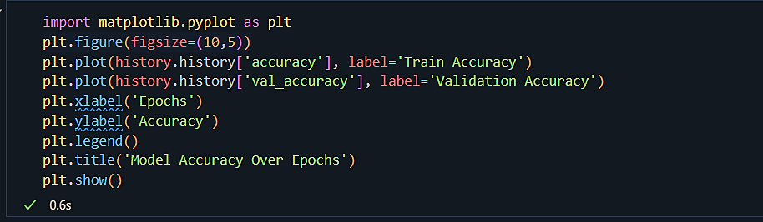
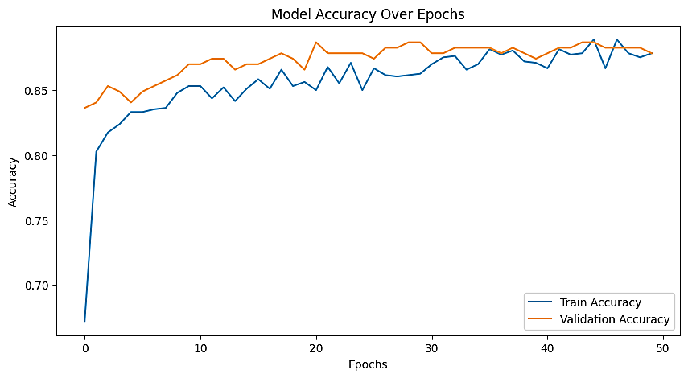
Visualization
Aritra Mukherjee

Slide 13
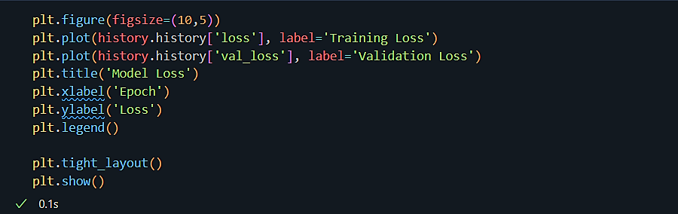
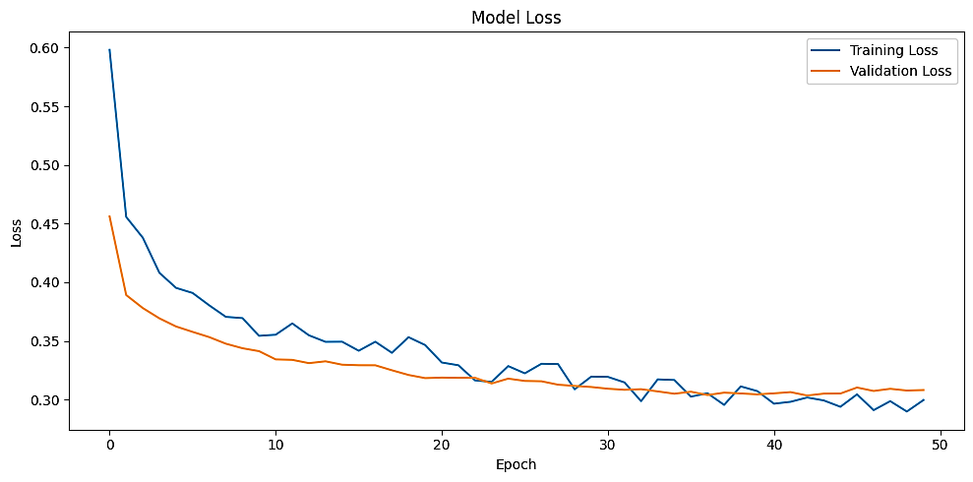
Visualization
Aritra Mukherjee

Slide 14
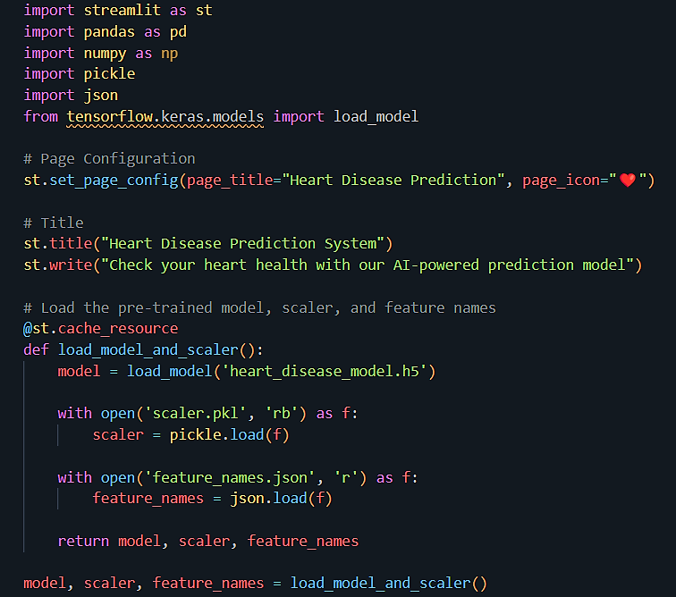
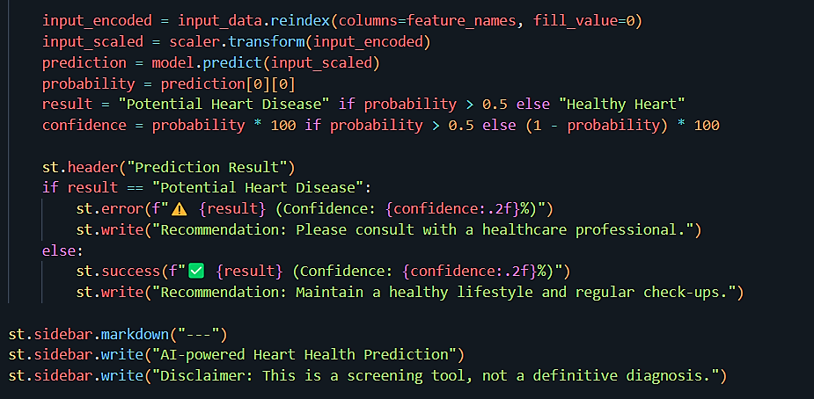
Frontend with Streamlit
…

Slide 15
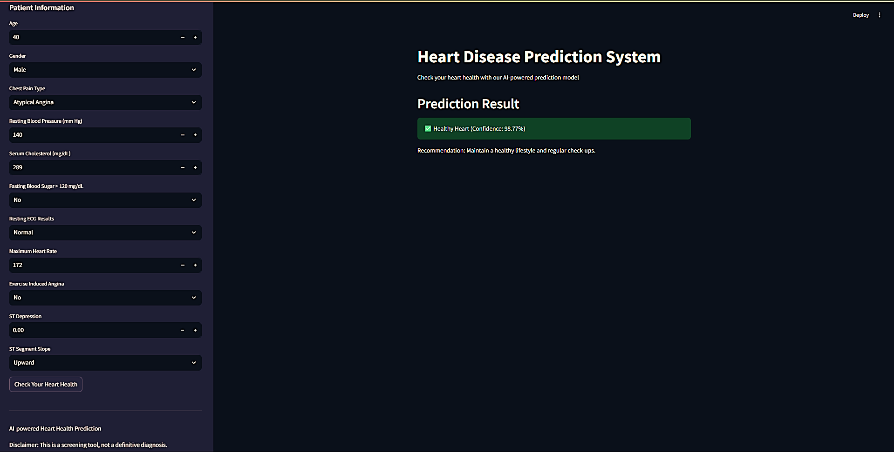
Prediction
Aritra Mukherjee

Slide 16
GitHub Repo
GitHub Repo-
Ai-Heart-Health
Aritra Mukherjee

Slide 17
Conclusion
Developed an AI-driven heart disease prediction system.
Achieved accurate classification using deep learning.
Scalable and interactive via Streamlit for real-world usability.
Supports early screening and promotes health awareness.
Aritra Mukherjee

Slide 18
Thank You!

